Slide 1
CS 437: Introduction to Machine Learning
Project: Exploring Mental Health Data
(Kaggle Playground Series – Season 4, Episode 11)
Abu Horaira Hridhon
Group Name: Lone Wolf
Course Instructor: Dr. Grant Williams
Notes:
Remember to hit the reset button to make sure all the page elements react properly.
There are 20 different layouts that you can choose from.

Slide 2

Introduction
WSU
This dataset was collected as a survey to understand the factors contributing to depression risk among adults.
The survey was conducted across various cities, targeting individuals from diverse backgrounds and professions.
Participants, ranging from 18 to 60 years old, provided inputs on factors such as age, gender, city, degree, job satisfaction, study satisfaction, study/work hours, and family history among others.
The target variable, 'Depression', represents whether the individual is at risk of depression, marked as 'Yes' or 'No’.
This is a binary classification problem.
In the competition, submissions were evaluated using “Accuracy” score.

Slide 3
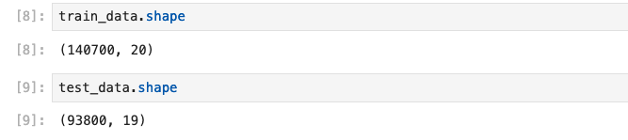
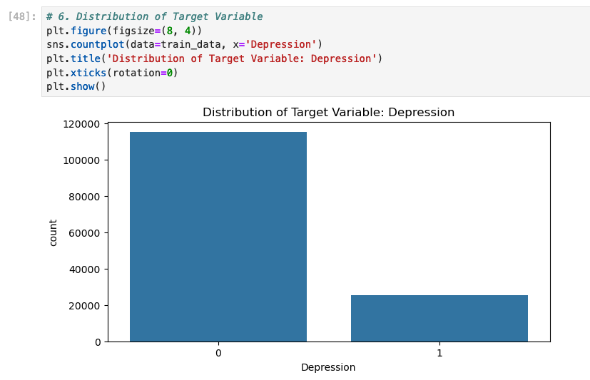
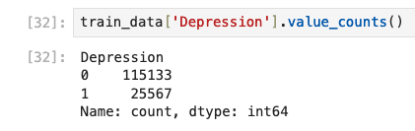
Data Analysis
WSU
There are two CSV files here. Train data and test data.
Train data has 19 non-target features, and the target feature ‘Depression’
Test data does not have the ‘Depression’ label
We can see that the dataset is imbalanced, so we will also observe precision, recall, and f1-score.

Slide 4
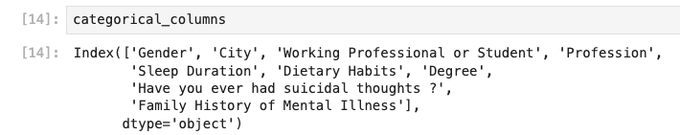
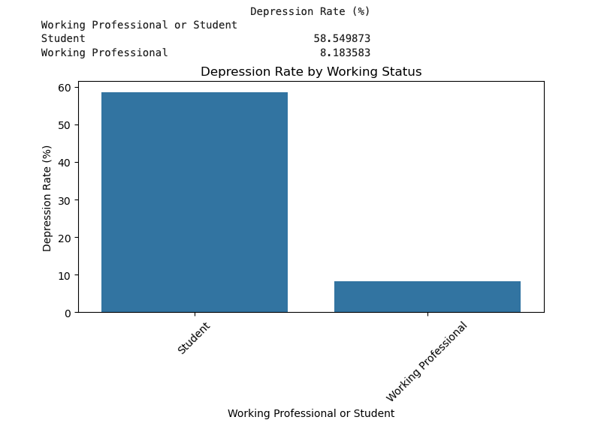
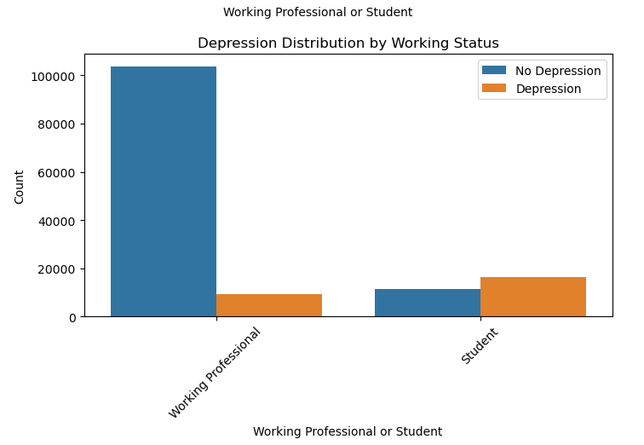
Data Analysis
WSU
More than 50% of the students are depressed.

Slide 5
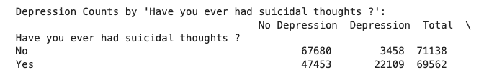
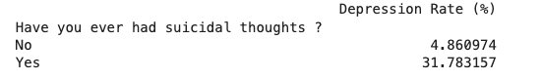
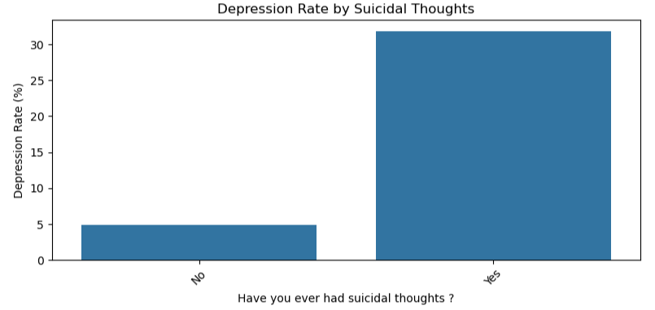
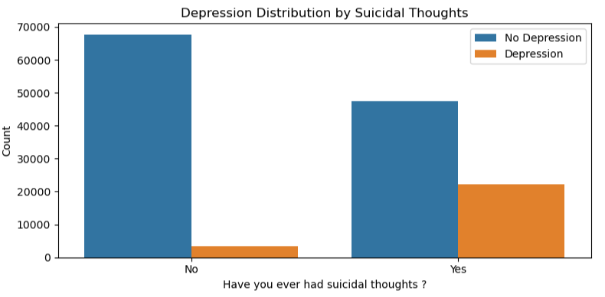
Data Analysis
WSU
‘Suicidal thoughts’ is another important parameter for indicating deprerssion.

Slide 6
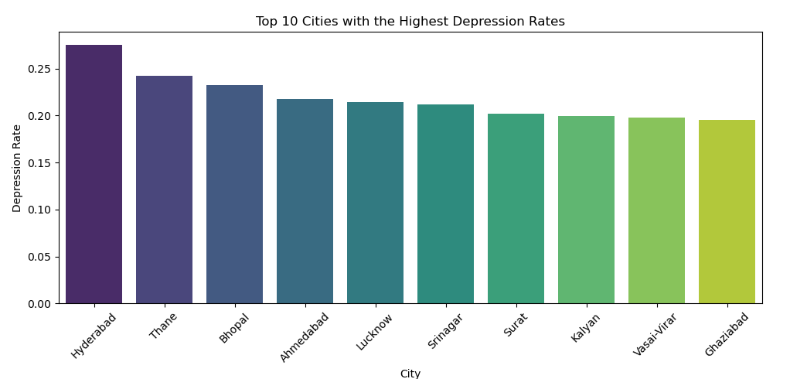
Data Analysis
WSU
Hyderabad has the most depression rate, interestingly, it is one of the most developed and industrialized cities in India.

Slide 7
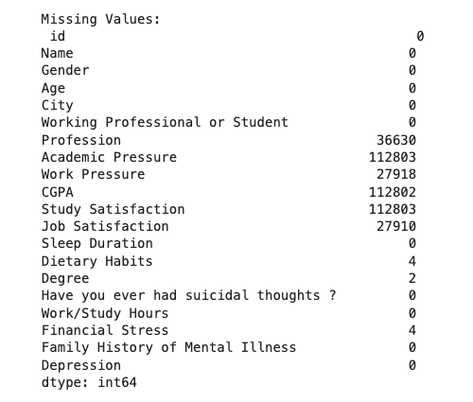
Data Analysis: Missing Values
WSU
Here, ‘Profession’, ’Work Pressure’, ‘Job satisfaction’ were not aplicable for students.
‘Academic Pressure’, ‘CGPA’, ‘Study Satisfaction’ were missing for the working professionals.

Slide 8
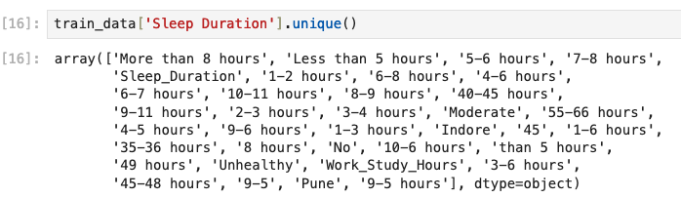
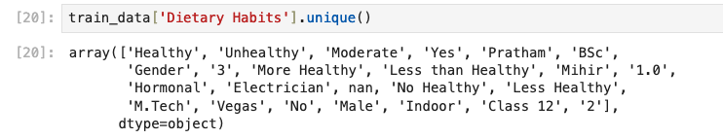
Challenges: Invalid Values
WSU
In the categorical features like ‘Sleep Duration’, ‘Dietary Habits’, ‘Profession’, ‘Degree’, and ‘City’, there were some invalid values.

Slide 9
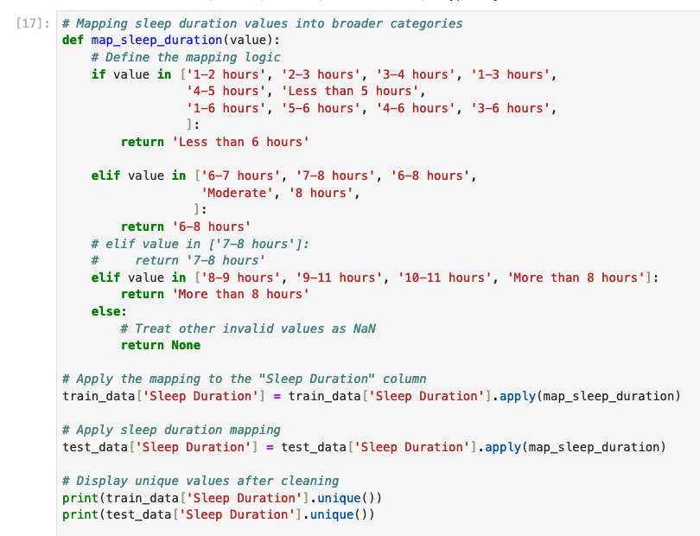
Mapping of Sleep Duration
WSU

Slide 10
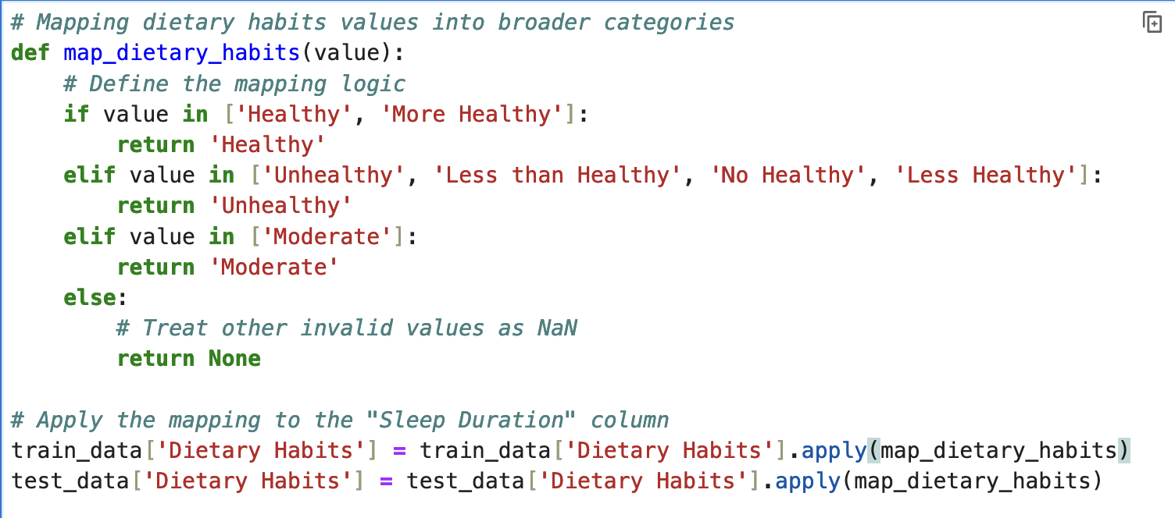
Mapping of Dietary Habits
WSU
Similarly, mapping was done for other cateforical features like,
‘Profession’,
‘Degree’, and
‘City’

Slide 11
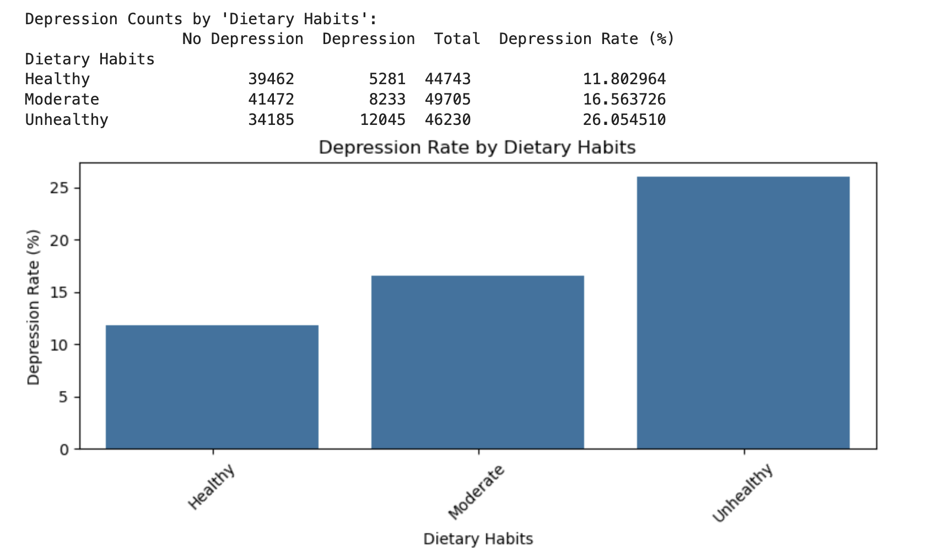
Mapping of Dietary Habits
WSU
After mapping, the relations between features like ‘Dietary Habits’ and target ‘Depression’ become more evident.

Slide 12
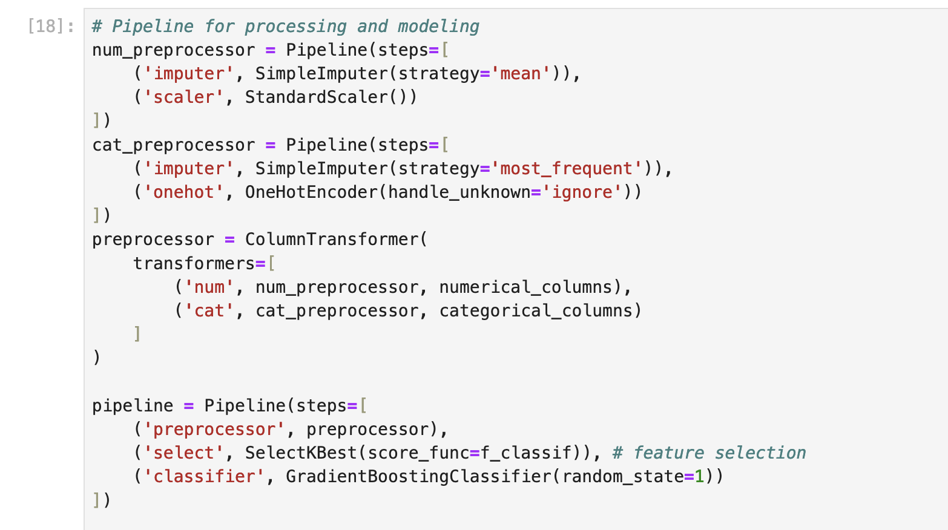
Pipeline
WSU
Imputing missing values with mean
Scaling the numerical features
Imputing missing values with mode
One-hot encoding in the pipeline
instead of pandas get_dummies
3 stages in the pipeline

Slide 13
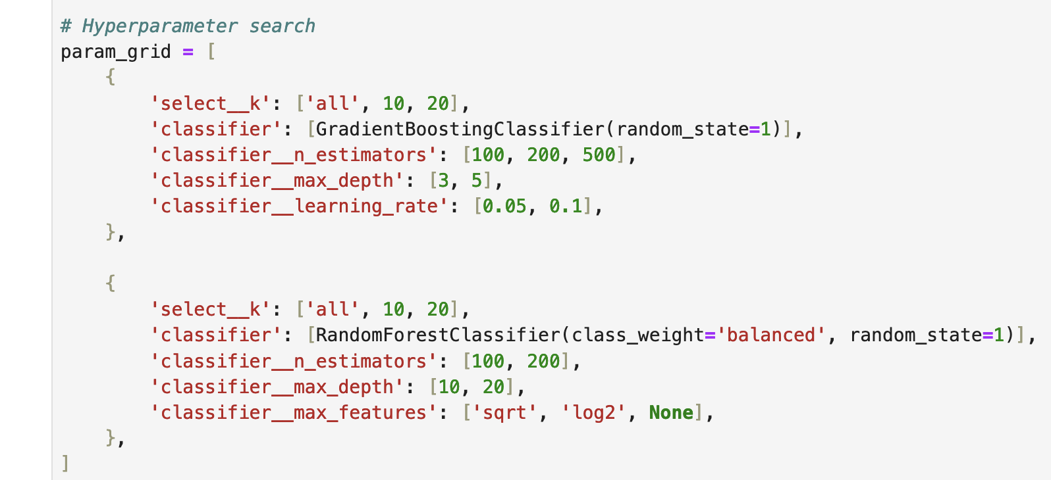
Grid
WSU

Slide 14
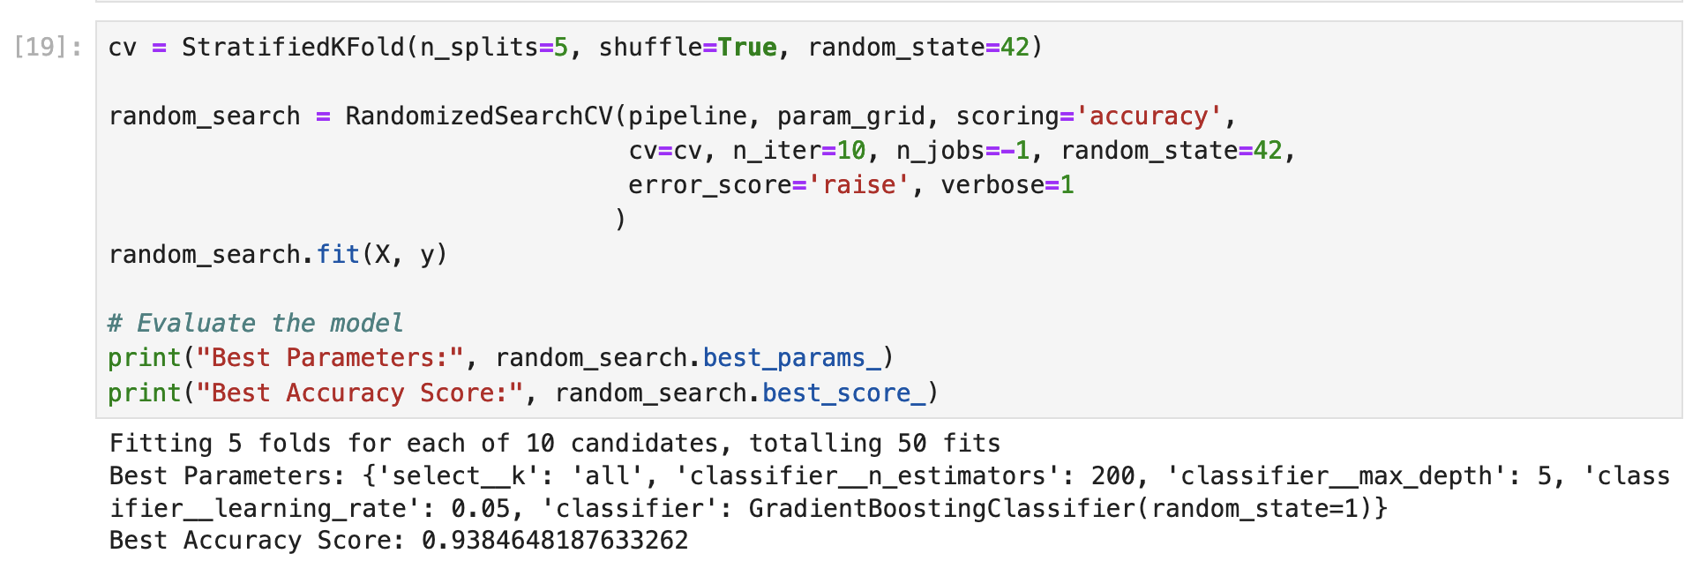
Optimization Pass
WSU
Gradient Boosting Classifier (GBC) showed better performance.
GBC can capture non-linear interactions between features. Including all features provides more data for the model
to learn from.
Interestingly, 200 estimators worked better than 500 estimators for the GBC. With 500 trees, the model might become
too complex and start overfitting to the training data.

Slide 15
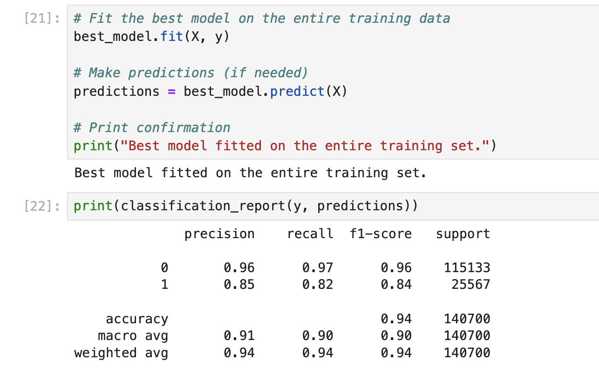
Performance on Training Data
WSU
No Depression
Depression
Precision and recall could have been better for
correctly identifying depression.
But for the competition, accuracy was prioritized
in the RandomizedSearchCV.

Slide 16
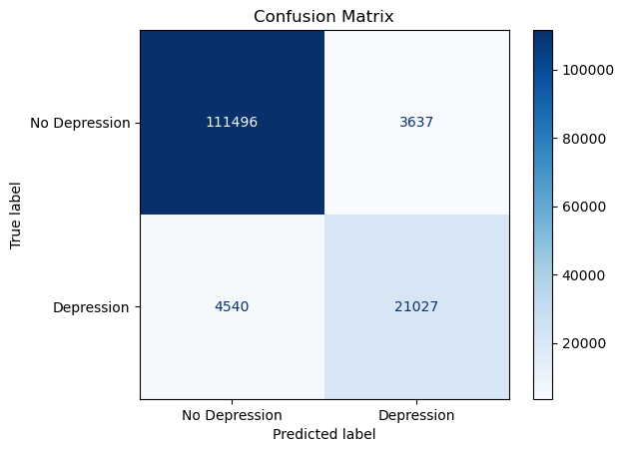
Confusion Matrix
WSU
Accuracy: 0.9419
Precision: 0.9412
Recall: 0.9419
F1 Score: 0.9415
These are all weighted values.
This could have been lowered if ‘recall’ had been focused on RandomizedSearchCV

Slide 17
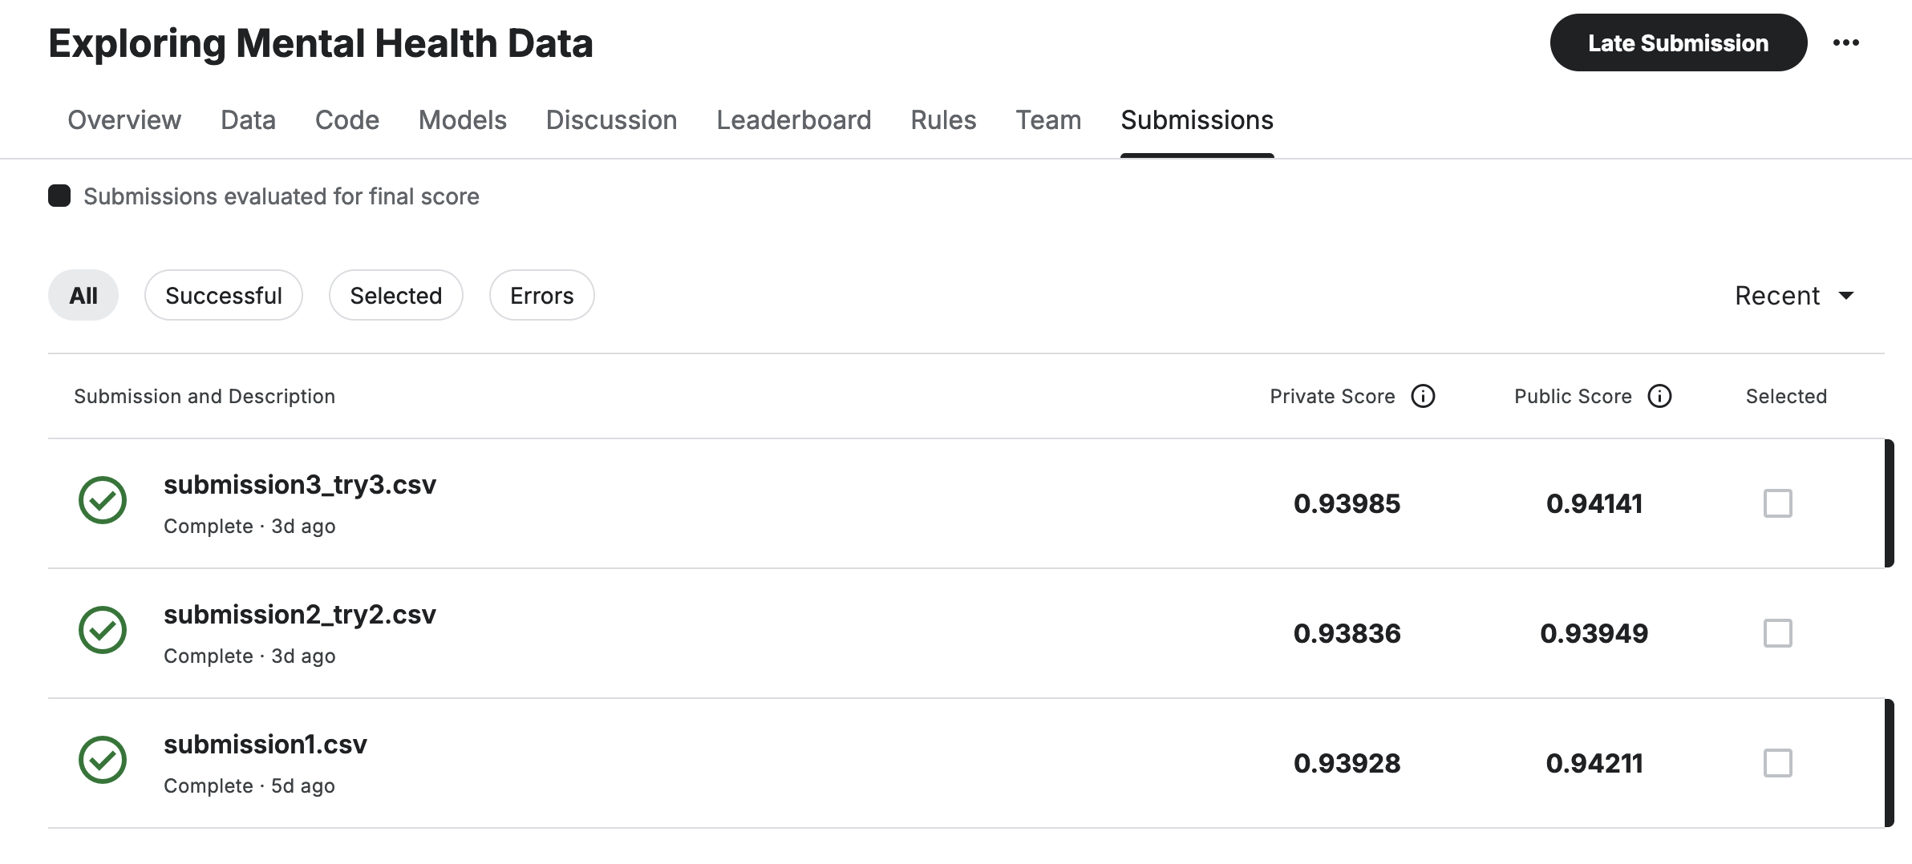
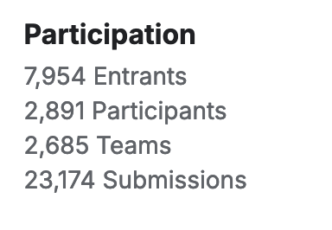
Performance on Test Data
WSU
Rank: 1229/2685 (54th Percentile)

Slide 18
Reflections
WSU
Accuracy on training data is 0.9419 and on test data 0.93985, so overfitting likely did not occur.
Highest accuracy score on the competition was 0.94184.
XGBoost and/or LightGBM could have been applied for increasing accuracy.

Slide 19

Thank You

